Slide 1



3D Mobile Application for Learning Human Brain.
Supervised by:
Dr. Ahsanullah Abro
Team Members:
Mohammad Hasnain
Sajjad Ali
Mujeeb Ahmed

Slide 2
Outline
Introduction & Background
Problem Statement
Proposed Solution
Objectives
Literature Review
Methodology
Expected Results
Scope of the Project
Gantt Chart
Work Division

Slide 3


Introduction & Background
The Brain is the most important and complicated organ in the human body.
It controls and coordinates all the actions and reactions that we make.

Slide 4

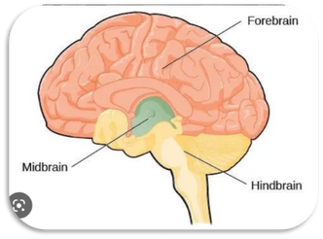
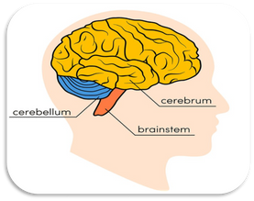
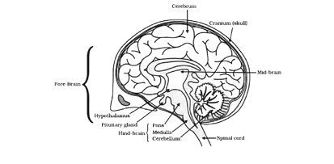
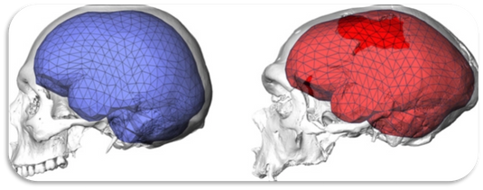
Introduction & Background
The human brain is studied by considering its four perspectives
Taxonomy
Anatomy
Physiology
Morphology

Slide 5
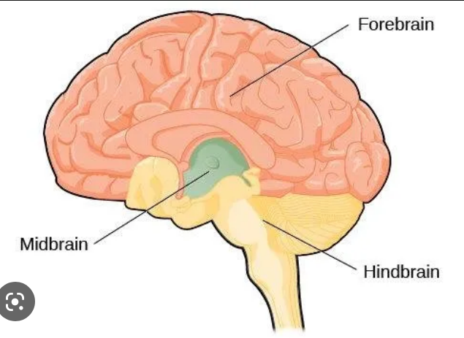
Introduction & Background
Taxonomy of Human Brain
Study of classification of the Brain
Forebrain
Midbrain
Hindbrain

Slide 6
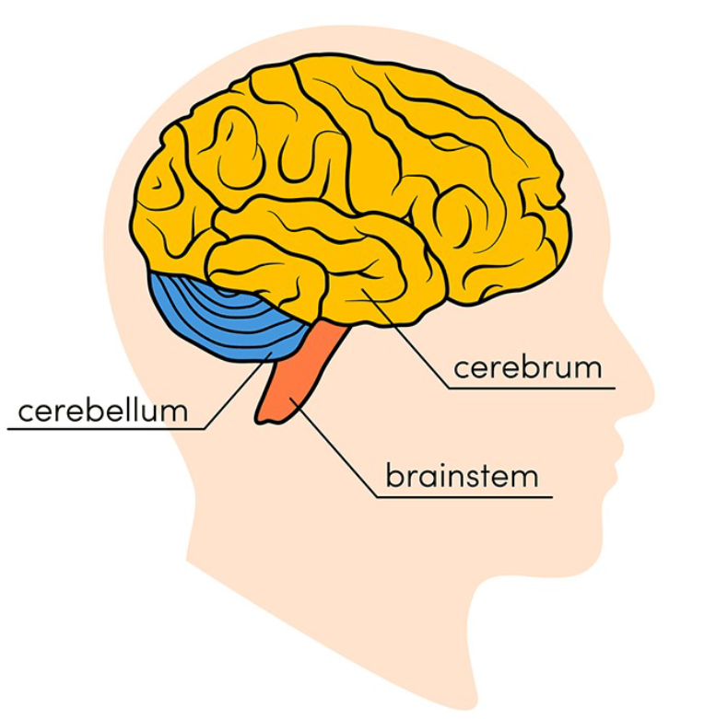
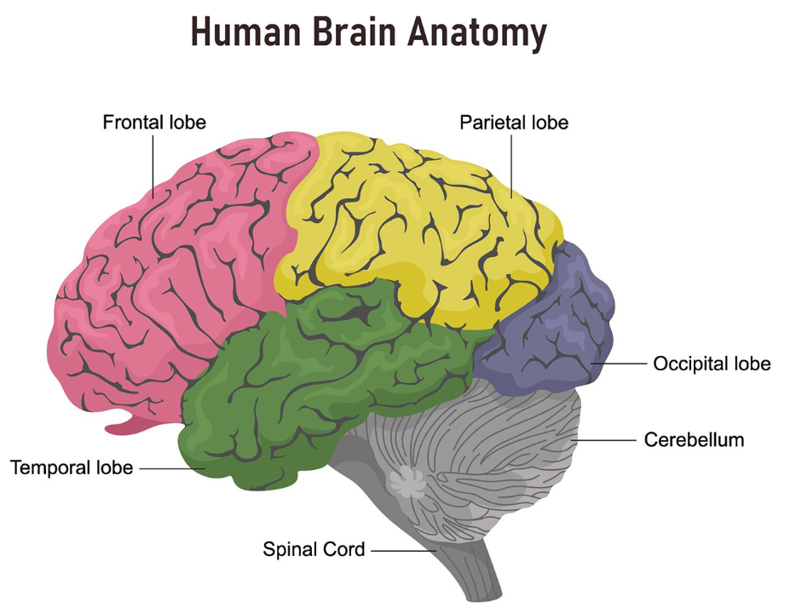
Introduction & Background
Anatomy of Human Brain
Study of structural parts of human brain

Slide 7

Introduction & Background
Physiology of Human Brain
Study of functions and activities of human brain

Slide 8
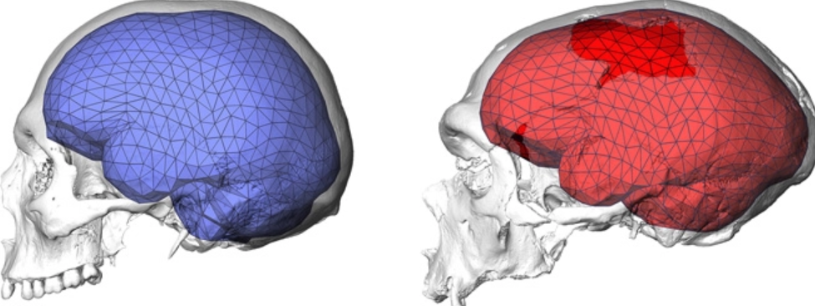
Introduction & Background
Morphology of Human Brain
study of the structural measures of the brain, e.g., volume and shape

Slide 9


Problem Statement
Students frequently run into difficulties when studying the human brain, especially college students or beginners.
Lack of 2D/3D desktop/mobile applications

Slide 10

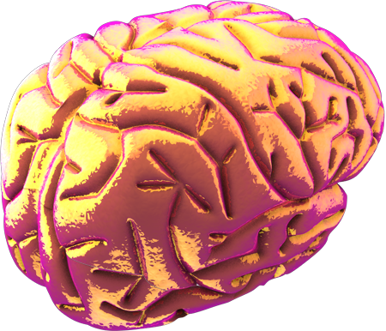
Proposed Solution
Develop a 3D mobile application for understanding the human brain.
Focus on the morphology, anatomy, physiology, and taxonomy of the human brain.
System that boosts positive usability.

Slide 11


Objectives
Our project's major goal is to design and create a 3D application
Deploy it on Android device

Slide 12
Literature Review
3D Human Brain
3D app for Android/Windows platform
Visualization of brain using 3D models
Does not the description of brain, or its interior organs

Slide 13
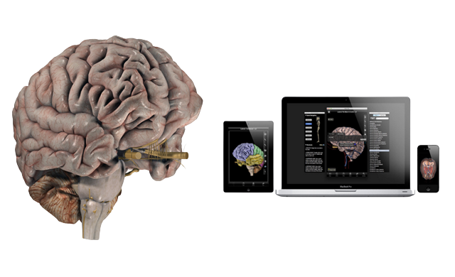
Literature Review
Brain Pro
Mac edition 3D app
Contains wonderful features for the anatomical perspectives of the brain.
Allows sectioned views and custom label
360-degree rotation and slice
View, Edit and Add pins with notes
Layers, Map and Transparency

Slide 14
Literature Review
Brain Pro
Limitations
Does not contain Taxonomy, Physiology, and Morphology
Only available for MAC.
Not free

Slide 15

Scope of the Project
Focus on the basic introduction of the human brain
Taxonomy, Anatomy, Morphology, and Anatomy
Functions of different components of brain

Slide 16
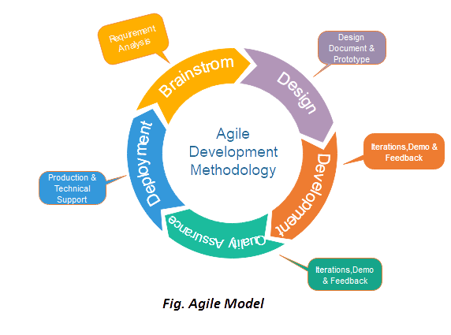
Methodology
Extreme Programming (XP) discipline of Agile.
Shorter development time
Control over cost and schedule
Accepting changes
Producing high-quality projects.
Agile Model

Slide 17

Methodology
Agile Model
The following are four values of agile methodology:
Requirements gathering
Design the requirements
Construction/ iteration
Testing/ Quality assurance
Deployment
Feedback

Slide 18



Expected Results
Efficient Learning of the Human Brain
Mastering the study of brain from different perspectives.
Visualization of brain from different angles and magnifications

Slide 19
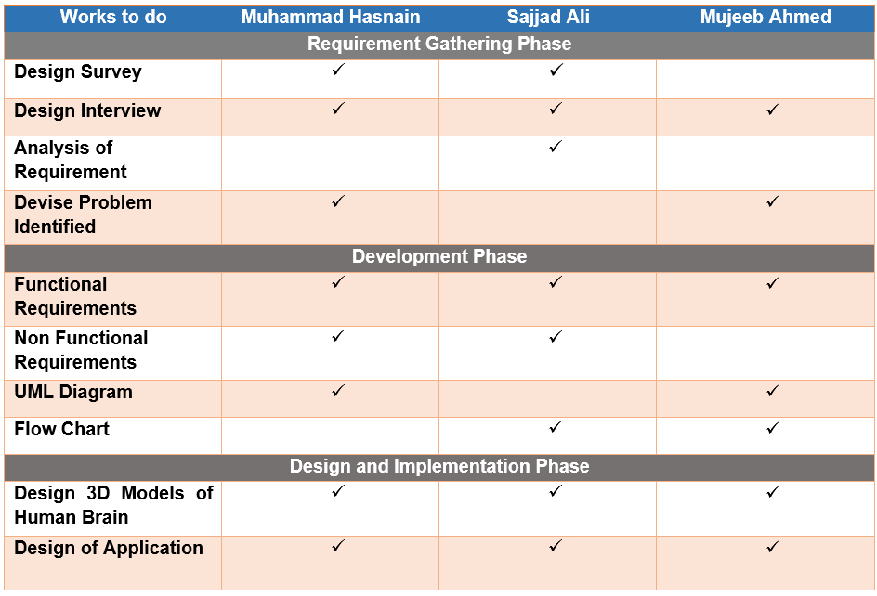
Work Division

Slide 20
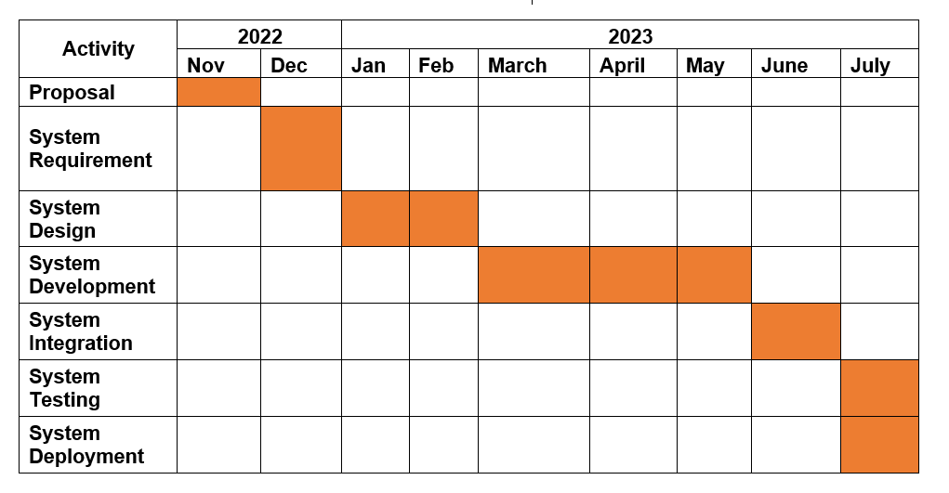
Gantt Chart

Slide 21

Thanks!

